Slide 1
Branding and User Experience

Slide 2
Branding tips
Why brand a website?
Color
Layout
Typography

Slide 3
Why brand a website?

Slide 4
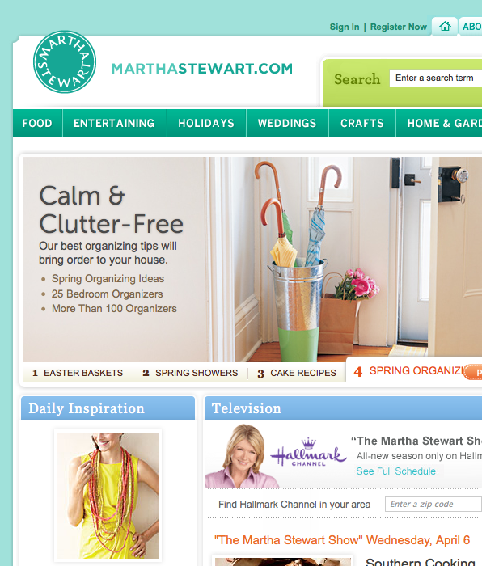

Branding helps users recognize which pages belong to the brand
≠

Slide 5


Different brands = different perceptions

Slide 6
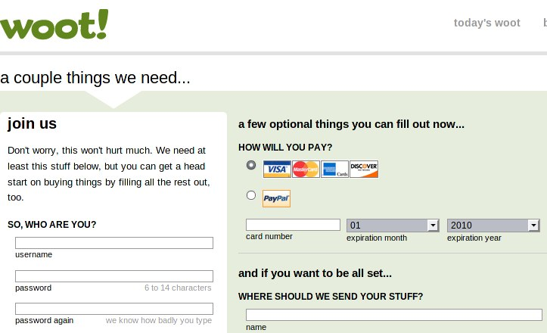
Branding imbues the brand's values onto the page

Slide 7

…or the pages themselves can establish the brand

Slide 8
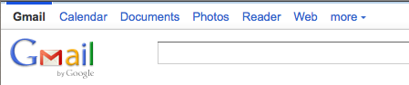
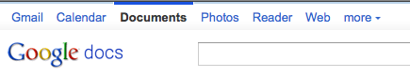
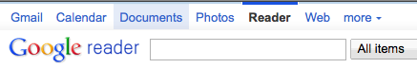
Let users learn your brand by repetition

Slide 9
Color

Slide 10

Reinforce brand colors in your color scheme!

Slide 11

What do you think is this brand’s color?

Slide 12

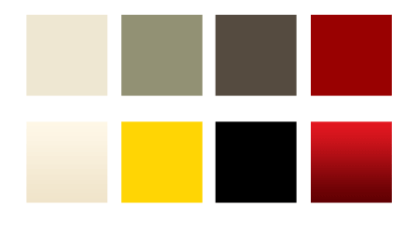
You may need to adapt the logo’s color palette…
Darker red than logo for normal site use. Also gradients used.

Slide 13


Slide 14
Layout

Slide 15

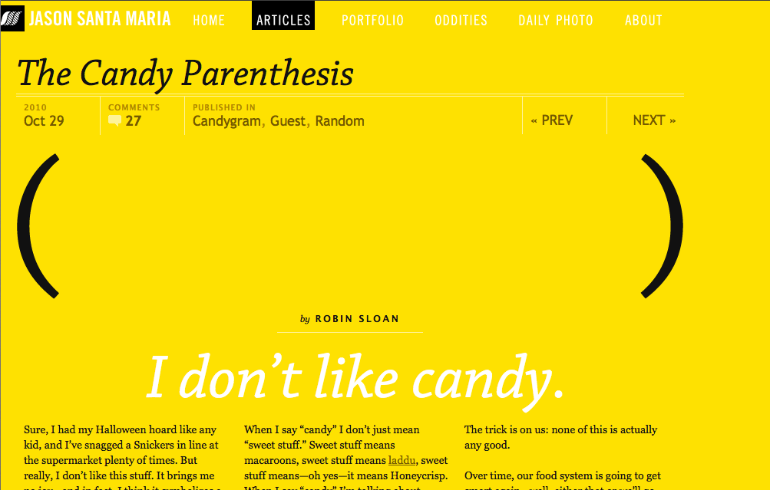
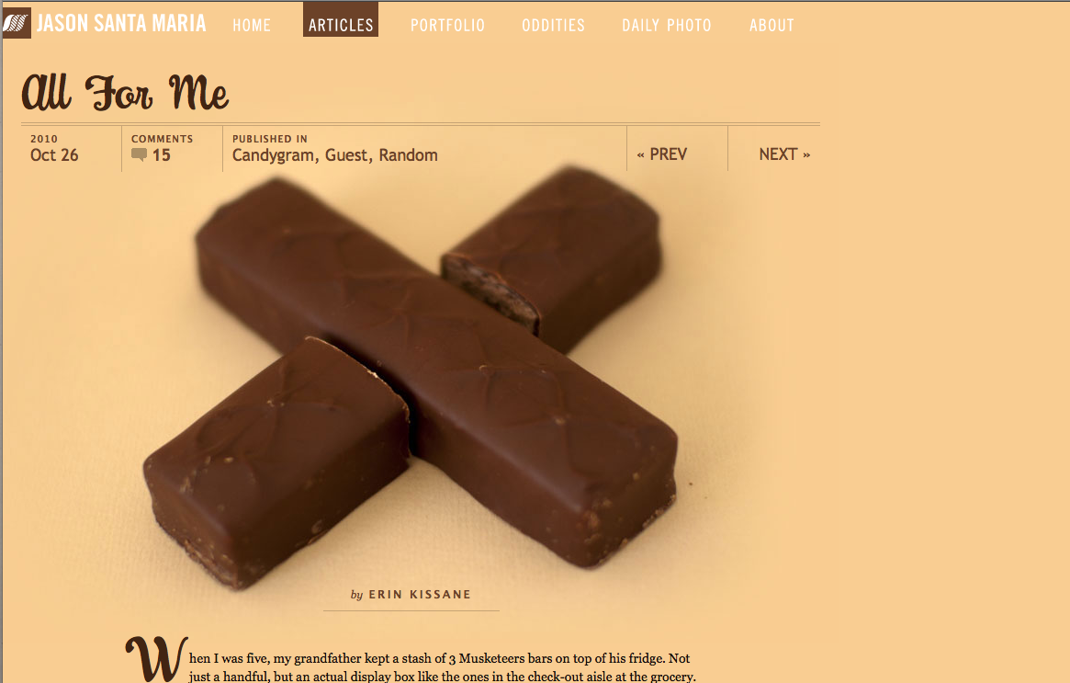
Similar headers maintain brand

Slide 16
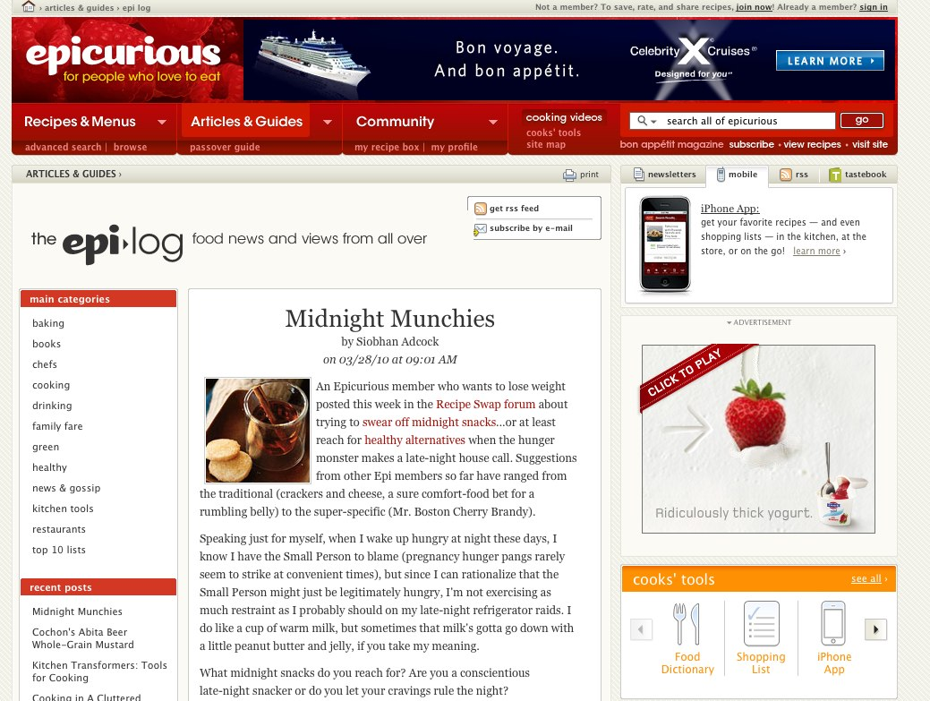
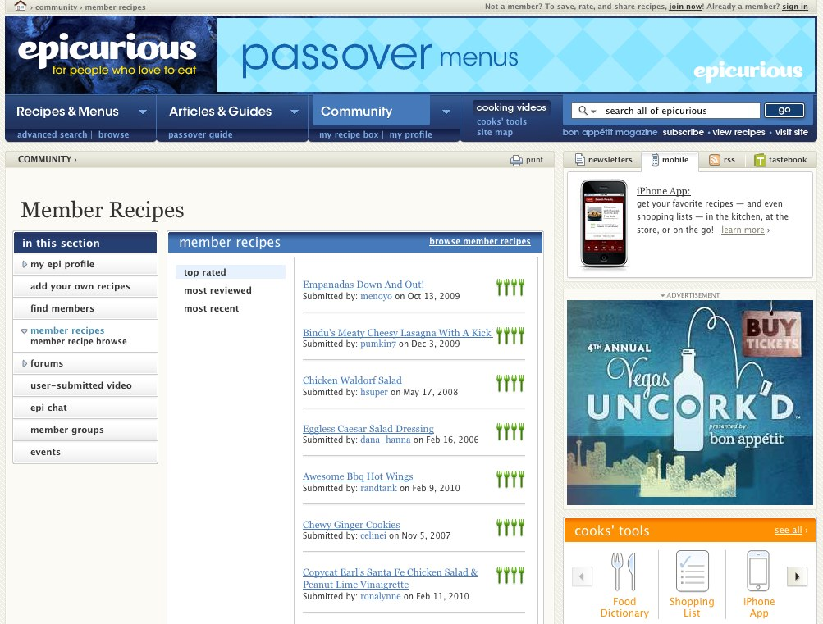

Same layout but different color harmonies

Slide 17


Be sure each set of colors is still legible!
Background vs text colors are too similar!

Slide 18
Typography

Slide 19
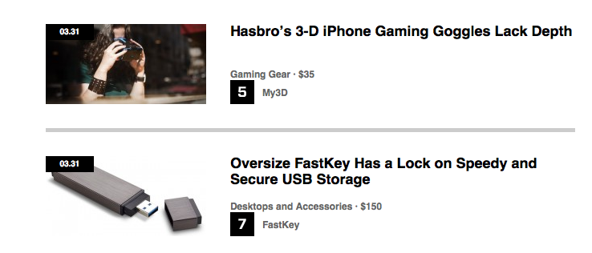

Use an interesting (but legible!) typeface

Slide 20
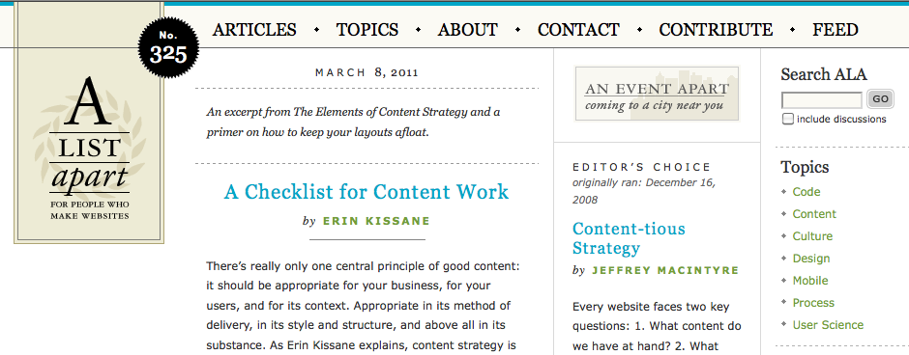
Try mixing serif/sans-serif

Slide 21
Wrapping up

Slide 22
Branding
Why brand a website? – Support, reinforce brand
Color – Create a palette complementing the logo
Layout – Sections are simlar but different
Typography – Use legible, interesting typfaces

Slide 23
Does your site’s branding send the right message?

Slide 24

Yale University School of Art

